Slide 1

Introduction to Azure API Management
<Presenter Name>
<Presenter Title>
<company / contact info>
Microsoft Azure

Slide 2
API Management solutions help organizations expose and publish their backend services as APIs for external and internal consumption. Join us to find out more about the new API Management capability in Azure. In addition to taking a tour of the product and its capabilities, we discuss the business of APIs, why we think the API Management space is important, and how our solution can help you and your customers.
Watch the recorded version of this presentation at http://channel9.msdn.com/Events/TechEd/NorthAmerica/2014/DEV-B351

Slide 3
welcome.

Slide 4
introduction to azure api management.

Slide 5
and you are?

Slide 6
IT Pro or Developer?

Slide 7
let’s talk about apis and how they can boost your business

Slide 8
Extending a platform
new channels, more customers
developers
API
partners
employees

Slide 9







“In little more than a decade, APIs have transitioned from relative obscurity to become the ‘digital glue’ that empowers developers to create new software applications, partnerships and even new businesses. This business-to-developer market is quickly becoming one of the fastest growing opportunities within cloud computing”
Byron Deeter, partner at Bessemer Venture Partners. Investor in Box, DocuSign, Twilio and SendGrid.
http://venturebeat.com/2013/08/31/api-economy/

Slide 10
Business models
direct monetization
public
private
Indirect monetization

Slide 11
So you want an API program?
How do you engage with developers?
How do you reduce TTFSC?
How do you enforce your business policies?
How do you make your legacy API modern?
How do you understand their behavior?
How do you protect your core business systems?
API Management

Slide 12

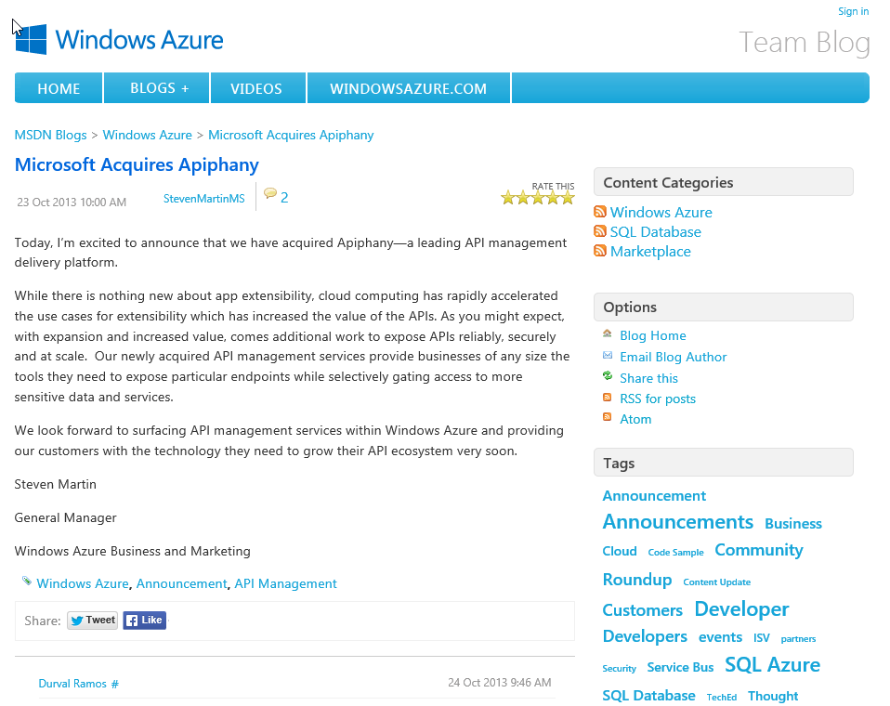
October 23, 2013

Slide 13

AZURE API MANAGEMENT

Slide 14
WINDOWS AZURE API
DEVELOPER PORTAL
DEVELOPERS
PROXY
API
APPS
PUBLISHER
PORTAL
Can be hosted anywhere and authored in any language on any platform.
PUBLISHER / ADMIN
AZURE API
MANAGEMENT

Slide 15
Demo Azure API Management
Notes:
Demo flow can be found at http://channel9.msdn.com/Events/TechEd/NorthAmerica/2014/DEV-B351

Slide 16
much preview, nice feature
Developer Experience
Self-Registration
Subscriptions
Documentation
Console
Issues Forum
Dashboard
Proxy & Policies
Call and bandwidth quotas
Rate limit
Caching
HTTPS
Authenticate with Basic
CORS / x-domain calls
Find and replace string
Re-write URL
Mask URLs
JSONP
JSON to/from XML
Set header or parameter
IP filter
Wildcard operations
Security
Custom developer ID
Social Developer ID
API key authentication
Basic Authentication
Reports
Calls
Bandwidth
Cache hits/misses
Status codes
API and service response time
Proxy response time
Filter any report by product API Operation
Admin Experience
API specification
Product management
Policies Editor
Developer management
Content management
Configurable notifications

Slide 17
Thanks
preview available in azure right now (go try)
updates already in the pipeline
… and more coming regularly
keen to engage with customers
reach us at apimgmt@microsoft.com

Slide 18




Thanks!
We are done now.

Slide 19
16 regions worldwide in 2014
Azure footprint

Slide 20
>57%
Greater than
1,000,000
>250k
Fortune 500 using Azure
Active websites
SQL Databases in Azure
>20
>1
TRILLION storage objects
>300
MILLION
AD users
MILLION
Developers registered with Visual Studio Online
>2
MILLION requests/sec
>13
BILLION
authentication/wk

Slide 21
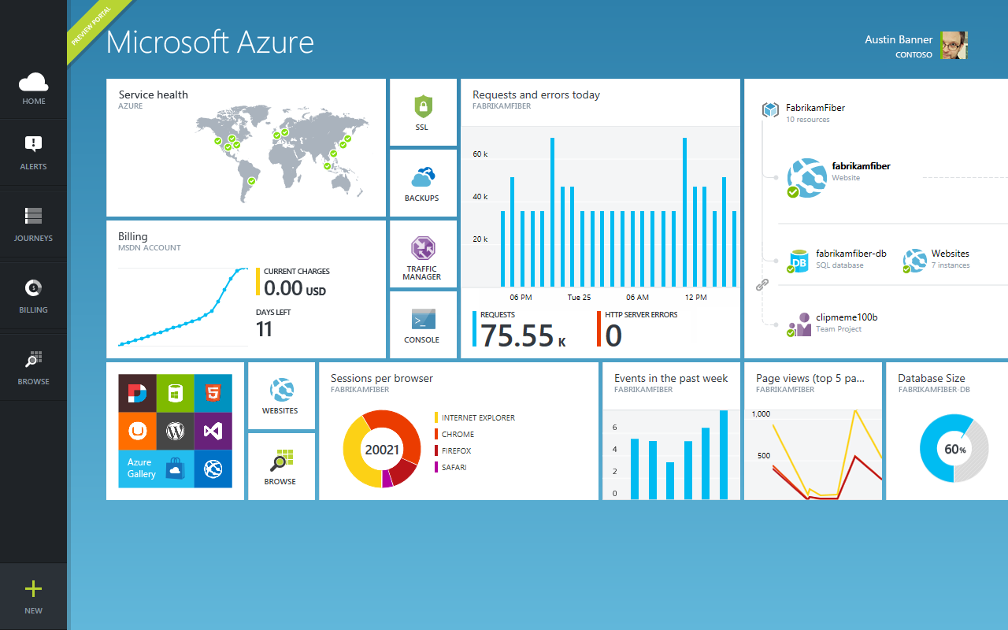

Slide 22

Get started
Visit azure.microsoft.com

